Slide 1

QRizza
Smart dining with seamless QR-powered ordering
Functional Prototype ✅
Articulate Clear Benefits ✅
Opendata Portal - N/A
Github Push ✅
Cloud Run/Vercel/Github Pages ✅
Leverage Sponsor Platforms ✅

Slide 2
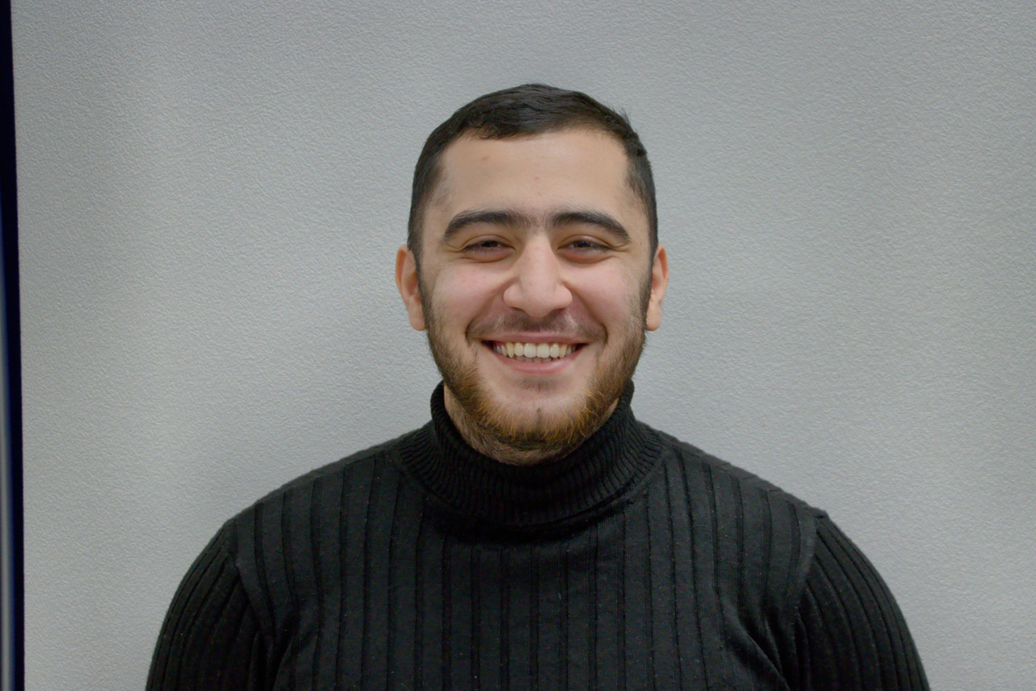
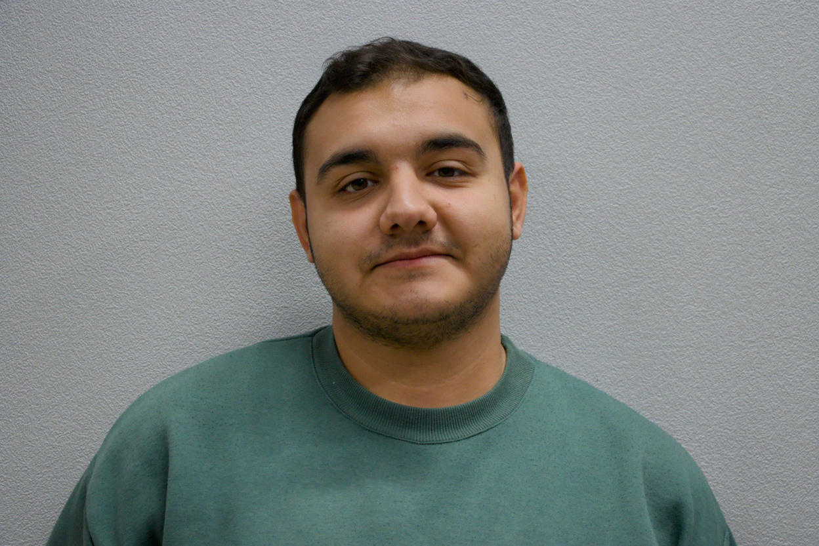
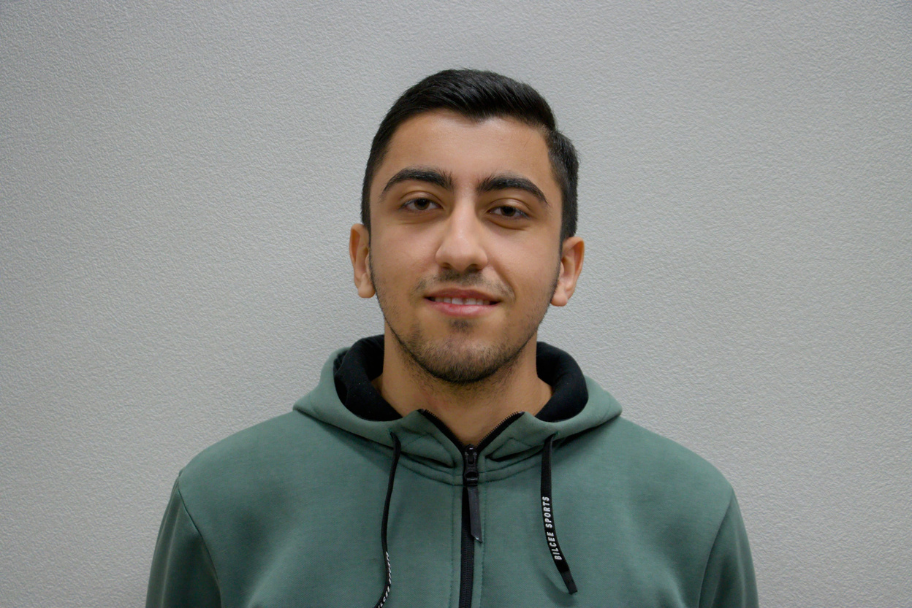
TEAM
Sadig Aliyev
CTO at PiTechs LLC
Programming Teacher in Evrika
Mahammad Aslanzade
Software Engineer at UniBank
Kamran Khalilov
Frontend Developer at Siesco

Slide 3
Problems
Problem 1
Slow and inefficient ordering process — customers wait for waitstaff to take orders, leading to delays.
Problem 2
Miscommunication between customers and waitstaff — errors in orders cause frustration and wasted resources.
Problem 3
Limited staff efficiency — waitstaff spend more time taking orders instead of focusing on service quality.

Slide 4

Solutions
Solution 1
Quick self-ordering from customer’s device, no waiting for staff.
Solution 2
Instant QR scan for waiters to get accurate orders fast.

Slide 5
How it works?
QRizza connects customers and waitstaff through a simple QR-powered process.
Customers browse the menu and place orders directly from their device. Once the order is submitted, a unique QR code is generated. Waitstaff scan this QR code to instantly view the customer’s order, ensuring fast and accurate service.

Slide 6
Target Market
TAM: There are over 22 million restaurants worldwide. With the growing adoption of digital ordering, a large portion of these can benefit from QRizza.
SAM: Focus on restaurants in Azerbaijan and neighboring countries (Turkey, Georgia, Russia). There are approximately 100,000 restaurants and cafés in this region.
SOM: Our initial focus is mid-sized restaurants and chains in Azerbaijan. By targeting 5–10% of the market, we can reach $6 - $12 million in annual revenue potential
$ 26.4B
TAM
$ 120M
SAM
$6M – $12M
SOM

Slide 7


Competitor Analysis
Table-Side QR Ordering
Waitstaff Integration
Error-Free Orders
Affordable SaaS Pricing
QRizza
GloriaFood
Square for Restaurants
Traditional POS Systems

Slide 8

Business Model
B2B Subscription
Monthly
Half-Yearly
Yearly
100 USD
500 USD
1000 USD
Best for testing
Most popular
Best value

Slide 9












Roadmap (2026)
Q1
Q2
Q3
Q4
Targeting
Promotion
Networking
Engagement
Pilot program with selected restaurants & cafés. Collect feedback and refine the product.
Launch marketing campaigns (social media, local events) to reach mid-sized restaurants.
Partnerships with restaurant associations and POS providers to expand adoption.
Introduce loyalty programs & advanced analytics to retain clients and upsell features.

Slide 10
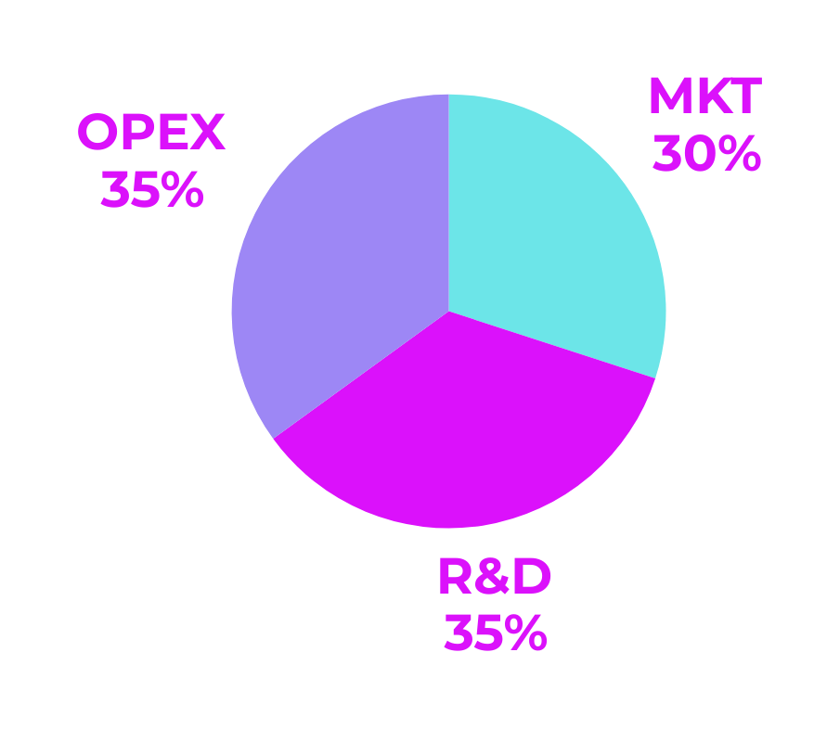
The Ask for Investment
$ 25000
Runway: 12 months
Equity : 10%

Slide 11
Thank you for your attention Sincerely,
QRizza
Join us in revolutionizing restaurant service with QRizza.

